Slide 1
mILK
FOOD COMMODITIES

Slide 2
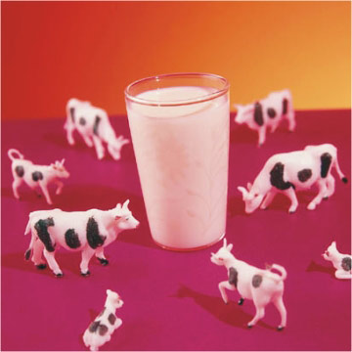
Composition of whole milk
Protein = 3.5%
Fat = 4%
Carbohydrates = 4.5%
Vitamins = A,B,D
Minerals = 0.7%
Water = 87%

Slide 3
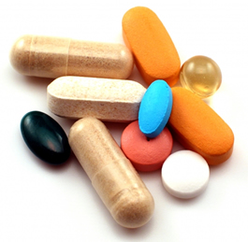
Nutritive Value
Protein –
High Biological Value protein
Easily digested form
Proteins present: Caseinogen,
Lactoalbumin
Lactoglobulin
Fat –
Saturated fat in form of tiny droplets
Easy to digest

Slide 4
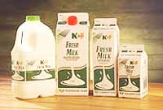
Nutritional value
Carbohydrates
Lactose, a disaccharide also called milk sugar
Lacks starch and cellulose
Vitamins
Vitamin A
B Group vitamins (riboflavin)
Small amounts of niacin and thiamine (destroyed during heat treatment)
Trace Vitamin D

Slide 5
Nutritional value
Minerals
Calcium and phosphorous
Small quantities of potassium and magnesium
Lacks iron
Water
High proportion of water (87%)

Slide 6
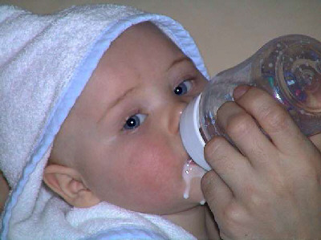
Dietetic value of milk
Very nutritious food.
Easily to digest, used in diet of invalids and elderly.
As milk is a good source of protein and calcium, it is important in diet of infants, children, teenagers, pregnant and nursing mothers.

Slide 7
Dietetic value cont...
Those on low cholesterol or low kilocalorie diets should use low fat/skimmed milk
Versatile food – many uses
Milk lacks iron, fibre, starch, vitamin C - use with cereals to balance diet

Slide 8
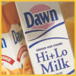
Types of milk
Whole Milk: most popular, full fat and pasteurised.
Skimmed Milk: fat has been removed.
Low-Fat: Some fat removed. Then pasteurised. Vitamins A and D removed as they are fat soluable.

Slide 9
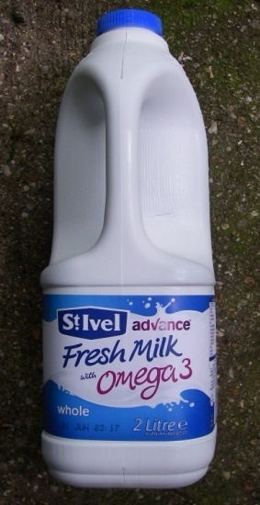
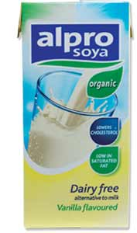
Types cont....
Fortified Milk or Super-Milk.
Vitamins and minerals added.
Soya Milk:
Made from the soya bean.
Buttermilk:
Form of skimmed milk that remains after butter has been churned. Soured using lactic acid bacteria and is useful in making brown bread and scones.

Slide 10
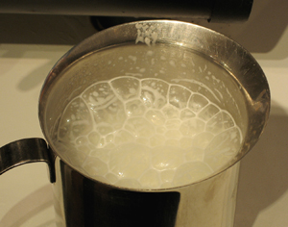
Effects of heat on milk
Protein coagulates forming a skin.
Bacteria are destroyed.
Some B vitamins lost.
Flavour changes slightly as lactose caramelises

Slide 11
Processing of milk
Milk is processed to improve flavour
Kill bacteria
Increase shelf life
Methods include:

Slide 12
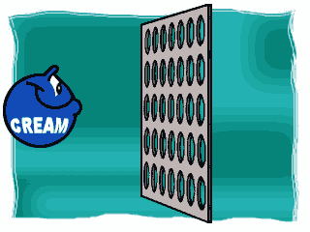
Homogenisation
Process | Effects
Milk is heated to 60ºC Then forced under pressure through tiny holes. This breaks up fat globules into fat droplets. | Smaller fat droplets are more evenly distributed through milk Fat does not rise to top of milk Milk is creamier, more flavour

Slide 13
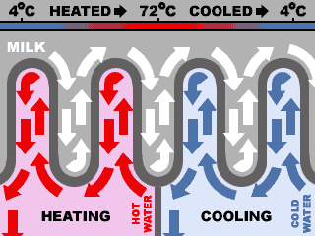
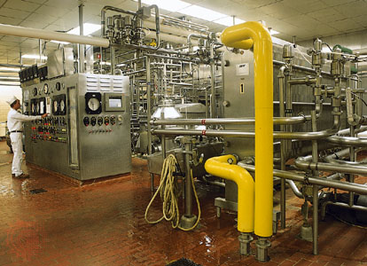
Pasteurisation
Process | Effects
Milk is heated to 72ºC for 15 seconds Then cooled rapidly to below 10ºC | Bacteria are destroyed Bacteria that sour milk are destroyed milk stays fresh for longer. No change in texture or flavour Loss of Vit C and thiamine

Slide 14
Sterilisation
Process | Effects
Milk is homogenised, sealed into bottles Then heated to 110ºC for 30 minutes Then cooled | If unopened milk will stay good for weeks. All micro-organisms are destroyed. Flavour changes. Loss of Vit C and B group vitamins.

Slide 15
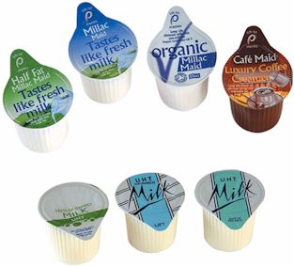
Ultra - Heat Treated (UHT) Sterilisation (long-life milk)
Process | Effects
Milk is heated to 132ºC for 1- 3 seconds Then cooled to 10ºC Packaged in sterile containers | Slight change in flavour Loss of Vitamin C and B All bacteria destroyed Milk keeps for months if unopened

Slide 16
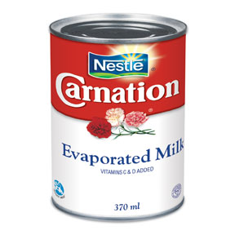
Evaporated milk
Process | Effects
Milk is pasteurised and evaporated to half its size. Then homogenised. Milk is sealed into cans and sterilised at 115ºC for 20 minutes. | Vitamin C and B group vitamins lost Flavour changes Bacteria destroyed Very long shelf life if unopened

Slide 17
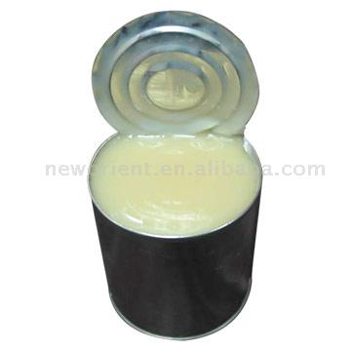
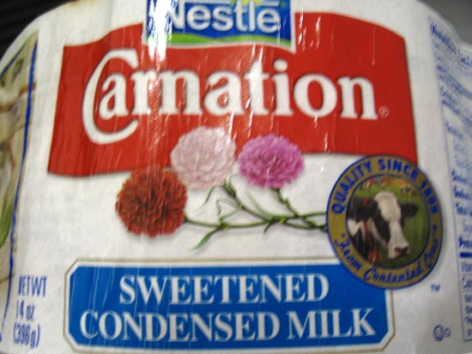
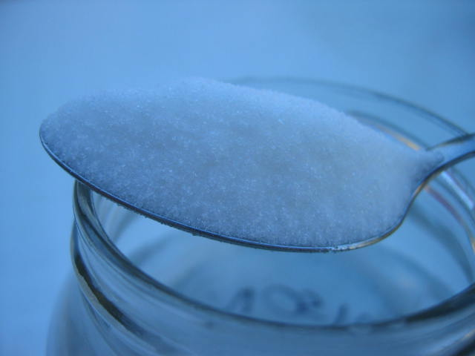
Condensed milk
Process | Effects
Milk is pasteurised . 15% sugar is added. Same as for Evaporated milk. | Increase in Carbohydrate (sugar). Same as Evaporated milk.

Slide 18
Dried/dehydrated milk
Process
Milk is homogenised
Then pasteurised
Evaporated to 60% of its original volume
It is dried by either:
Roller drying
Spray drying

Slide 19
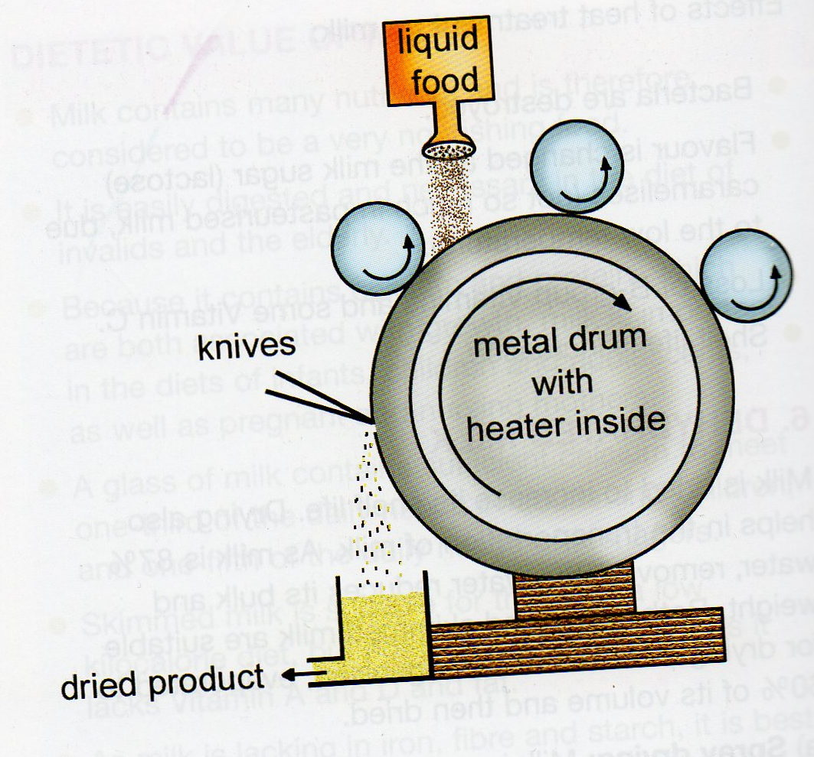
Roller drying
Process | Effects
Milk poured over heated revolving rollers As it dries it is scraped off. | Uneven powder Loss of vitamin B Bacteria destroyed Flavour changed (burnt flavour)

Slide 20
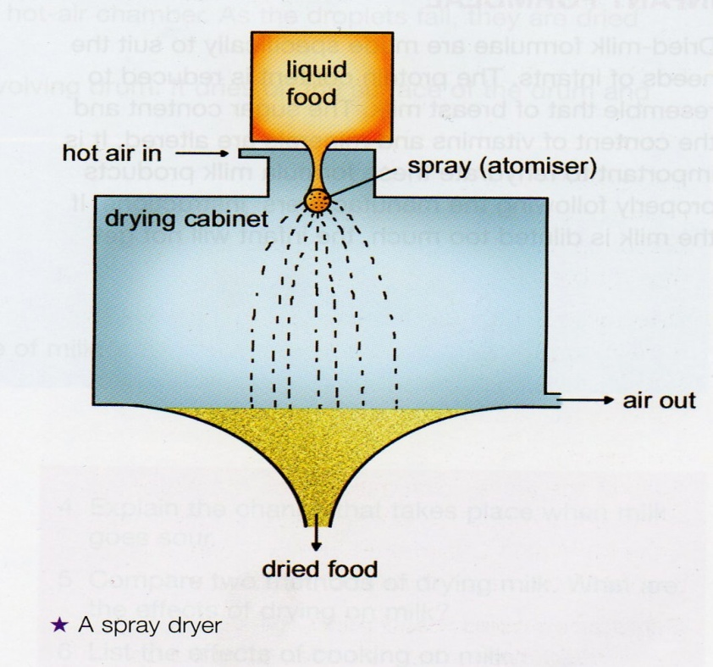
Spray drying
Process | Effects
Milk is sprayed into hot air chamber Droplets dry to a fine powder as they fall Dried milk is cooled Packed into airtight containers | Good quality powder Bacteria destroyed Better flavour than roller dried milk Rehydrates easily in cold water

Slide 21
Storing milk
Check best before date.
Store in refrigerator below 5ºC. This slows down growth of lactic acid bacteria, which cause milk to sour.
Keep milk covered.
Keep away from strong smelling foods.
Fresh milk keeps for 3-4 days.
UHT milk keeps for months unopened.

Slide 22
Questions
Give a detailed account of the nutritive value of whole milk
Name three proteins found in milk?
Explain the dietetic value of milk?
Why is skimmed milk not suitable for children?
Enumerate five types of milk currently available and suggest a use for each
Milk is a perishable food; explain what this means? Explain how milk spoils
What is homogenisation and why is this process carried out?

Slide 23
Questions
Why is milk heat-treated? Outline four treatments carried out on milk & explain the effects of such treatments on the nutritive value (method/temperature/time/effect)
What are the effects of cooking on milk?
Briefly explain two methods of drying milk and list the effects of drying on the nutritive value
List four points to consider when storing fresh milk

Slide 24
Questions
Outline the measures taken by the Dairy Industry to meet current trends in the eating patterns and lifestyles of the Irish consumer
Explain how i) advertising and ii) a person’s health status might influence decision making when purchasing dairy products

